Slide 1

Disease Prediction Using Multi-Model Deep Learning and Machine Learning Approach
Fusing Technology and Agriculture: A Smart Solution for Predicting Plant Diseases

Slide 2
Group Members
H. Rohitha Aiswarya Dora (AP21110011372)
K. Pranay Deep (AP21110011383)
D. Heswitha Reddy (AP21110011545)
K. Pavan Venkata Sai Teja (AP21110011590)
P. Sai Durga Vara Prasad (AP21110011632)

Slide 3
Introduction
Disease prediction stands as a critical facet of healthcare, demanding precision and adaptability in technological solutions.
Our study aims to leverage the power of deep learning models, specifically ResNet, MobileNet, and InceptionV3, for predicting plant diseases.
This research contributes to the broader field of agricultural science and technology, where the intersection of deep learning and plant pathology holds immense potential

Slide 4
Accurate prediction allows for proactive measures, preventing the spread of diseases and minimizing the impact on crop production.
“
”

Slide 5
Research Methodology
Training and evaluating models on the Plant Village dataset using TensorFlow and scikit-learn libraries.
Varied configurations, hyperparameter adjustments, and optimizer comparisons for comprehensive insights.

Slide 6
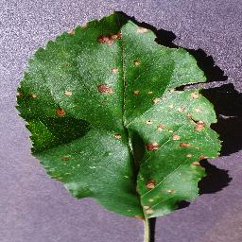
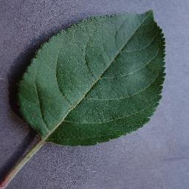
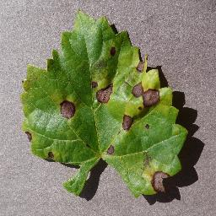
Plant Village Dataset
This dataset is a comprehensive collection of plant images covering various diseases and healthy specimens.
This is an annotated dataset with labels corresponding to each image.
(a) Apple_Black_Rot (b) Apple_Healthy (c) Grape_Blact_Rot

Slide 7
Background Work

Slide 8
Transfer Learning
Transfer Learning is a machine learning technique where a model developed for a particular task is used as the starting point for a model on a second task.
In deep learning, transfer learning involves using pre-trained neural network models trained on large datasets for a specific task, such as image classification.
These pre-trained models can be adapted for a different but related task with smaller datasets, providing benefits like faster training and improved performance.
Now, let's delve into more details about ResNet, InceptionV3, and MobileNet:

Slide 9
ResNet (Residual Network)
Known for its deep structure with residual connections.
Features skip connections that enable the model to learn residual functions.
Residual blocks facilitate the training of very deep networks.
InceptionV3
Utilizes inception modules for capturing features at various spatial scales.
Employs factorized convolutions and global average pooling.
Balances complexity with efficiency.
MobileNet
Lightweight design suitable for resource-constrained scenarios.
Uses depth-wise separable convolutions to balance accuracy and efficiency.
Commonly applied in mobile and edge device applications.

Slide 10
Model Architecture

Slide 11
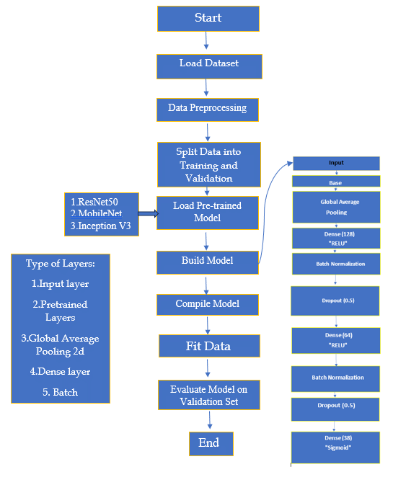
Model Flow Diagram
Configuring base layers, additional layers, and output layers.
Tailoring architectures with global average pooling, dense layers, batch normalization, and dropout for effective disease prediction.

Slide 12
Model Configuration

Slide 13
Exploring various configurations for each architecture, including different optimizers (Adam, SGD), learning rates, and batch sizes.
Model Number | BASE MODEL | Optimizer | Learning Rate | Batch Size | No of Epochs
Model 1 | ResNet50 | Adam | 0.01 | 32 | 20
Model 2 | ResNet50 | SGD | 0.01 | 32 | 20
Model 3 | ResNet50 | Adam | 0.001 | 32 | 08
Model 4 | ResNet50 | Adam | 0.001 | 64 | 08
Model 5 | MobileNet | SGD | 0.001 | 64 | 10
Model 6 | MobileNet | SGD | 0.001 | 32 | 10
Model 7 | InceptionV3 | Adam | 0.01 | 32 | 20

Slide 14
Evaluation

Slide 15
Model Performance
Model Number | ROC-AUC Score | Accuracy | Precision | Recall | F1 score
Model 1 | 0.94 | 0.9844 | 0.96 | 0.93 | 0.93
Model 2 | 0.98 | 0.9875 | 0.99 | 0.99 | 0.99
Model 3 | 0.98 | 0.9734 | 0.98 | 0.97 | 0.97
Model 4 | 0.95 | 0.9374 | 0.94 | 0.93 | 0.93
Model 5 | 0.93 | 0.9431 | 0.94 | 0.94 | 0.93
Model 6 | 0.93 | 0.9709 | 0.97 | 0.97 | 0.97
Model 7 | 0.82 | 0.9251 | 0.80 | 0.68 | 0.69

Slide 16
Conclusion
In conclusion, our exploration of ResNet, InceptionV3, and MobileNet in disease prediction, utilizing the Plant Village dataset, has illuminated the diverse strengths of each architecture. The meticulous study of hyperparameter configurations and optimizer roles underscores the need for nuanced choices in model development. The adaptability showcased by our multi-model approach emphasizes its relevance in addressing distinct datasets and prediction scenarios. As we unravel the complexities of healthcare analytics, these insights serve as a valuable compass for practitioners and researchers, steering the course toward enhanced disease prediction and improved healthcare outcomes.

Slide 17
Future Works
In future work, we plan to explore fine-tuning and transfer learning effectiveness, implement ensemble learning for robust predictions, investigate advanced data augmentation, integrate model explainability, address deployment challenges, and continuously optimize hyperparameters. Generalizing models across different disease domains is also a key focus, extending the impact of our research beyond plant pathology.

Slide 18
Thank you

